Slide 1

“REUSABLE CAPTCHA SYSTEM”
OOTs Using JAVA (BCSE0352/BMICSE0352/BCSEH0352)
Department of Computer Science and Engineering
CSE/ M.Tech Int. /CSE-R
(Submitted To: Mrs. Neetu Kumari Rajput )
Name of Member | Roll Number | Role | Department n Section
Harsh Sharma | 2401330130120 | Troubleshoting | IT - B
Priyanshu Yadav | 2401330130198 | System Designing | IT - C
Punit Sharma | 2401330130199 | GUI | IT - C
OOTs Using JAVA Project PPT 2025-26 Odd Sem

Slide 2

Index
Introduction
Literature Survey/Existing System
Problem Statement
Proposed Methodology
Flowcharts and Use Case/ER Diagrams
Feasibility Study
Hardware /Software Requirement
Results and Conclusion
References
Live Demonstration of Project with screenshots in ppt
OOTs Using JAVA Project PPT 2025-26 Odd Sem

Slide 3
INTRODUCTION
The Reusable CAPTCHA Security Engine is a security solution designed to protect web applications from bots and automated attacks. It verifies human users through dynamic CAPTCHA challenges like text, image, or puzzle tests.
This engine is reusable, secure, and easy to integrate, making it suitable for multiple platforms and projects. It helps prevent spam, unauthorized access, and data abuse while ensuring a simple and user-friendly experience.
OOTs Using JAVA Project PPT 2025-26 Odd Sem

Slide 4
LITERATURE SURVEY / EXISTING SYSTEM
.
Existing CAPTCHA systems like Google reCAPTCHA, hCaptcha, and text/image-based CAPTCHAs are widely used to protect websites from automated bots. These systems generate random challenges that humans can solve easily but bots cannot.
However, most existing solutions are platform-dependent, not fully customizable, and sometimes complex to integrate into smaller applications. They may also reduce user convenience due to difficult or repetitive verification tasks.
The need for a lightweight, reusable, and developer-friendly CAPTCHA engine led to the idea of building a custom solution that ensures strong security while maintaining ease of use and integration across multiple projects.
OOTs Using JAVA Project PPT 2025-26 Odd Sem

Slide 5
Existing System Limitations:
Most CAPTCHA systems rely on third-party services like Google reCAPTCHA.
Limited customization options for design and difficulty level.
Integration complexity in small or offline applications.
Poor user experience due to hard-to-read or repetitive challenges.
Need for an Improved System:
To develop a reusable and customizable CAPTCHA engine that fits any application.
To reduce dependency on third-party CAPTCHA services.
To provide a simpler integration process for developers.
To ensure stronger security against modern AI-based bot attacks.
OOTs Using JAVA Project PPT 2025-26 Odd Sem

Slide 6
PROBLEM STATEMENT
Existing CAPTCHA systems are third-party dependent and often difficult to customize or integrate into various applications.
Many provide complex or frustrating challenges, leading to poor user experience.
Some CAPTCHAs can be bypassed by advanced bots using modern AI and OCR technologies.
Developers have limited control over CAPTCHA design, validation, and data security.
There is a need for a reusable, secure, and user-friendly CAPTCHA engine that ensures high protection and easy integration across platforms.
OOTs Using JAVA Project PPT 2025-26 Odd Sem

Slide 7
PROPOSED METHODOLOGY
Develop a reusable CAPTCHA engine using secure and efficient coding techniques.
Implement dynamic CAPTCHA generation (text, image, or puzzle-based) to prevent bot recognition.
Use randomization and encryption to make each CAPTCHA unique and tamper-proof.
Design a validation module to verify user responses securely on the server side.
Create a developer-friendly API for easy integration into web and mobile applications.
Ensure lightweight performance and compatibility with multiple platforms.
Test the system for security, usability, and reliability against automated attacks.
OOTs Using JAVA Project PPT 2025-26 Odd Sem

Slide 8
EXPECTED OUTCOME:
A fully functional reusable CAPTCHA engine that can be easily integrated into various applications.
Enhanced web security by effectively blocking bots and automated scripts.
Customizable CAPTCHA types (text, image, or puzzle) for flexible use.
Improved user experience with simple, readable, and quick verification.
OOTs Using JAVA Project PPT 2025-26 Odd Sem

Slide 9
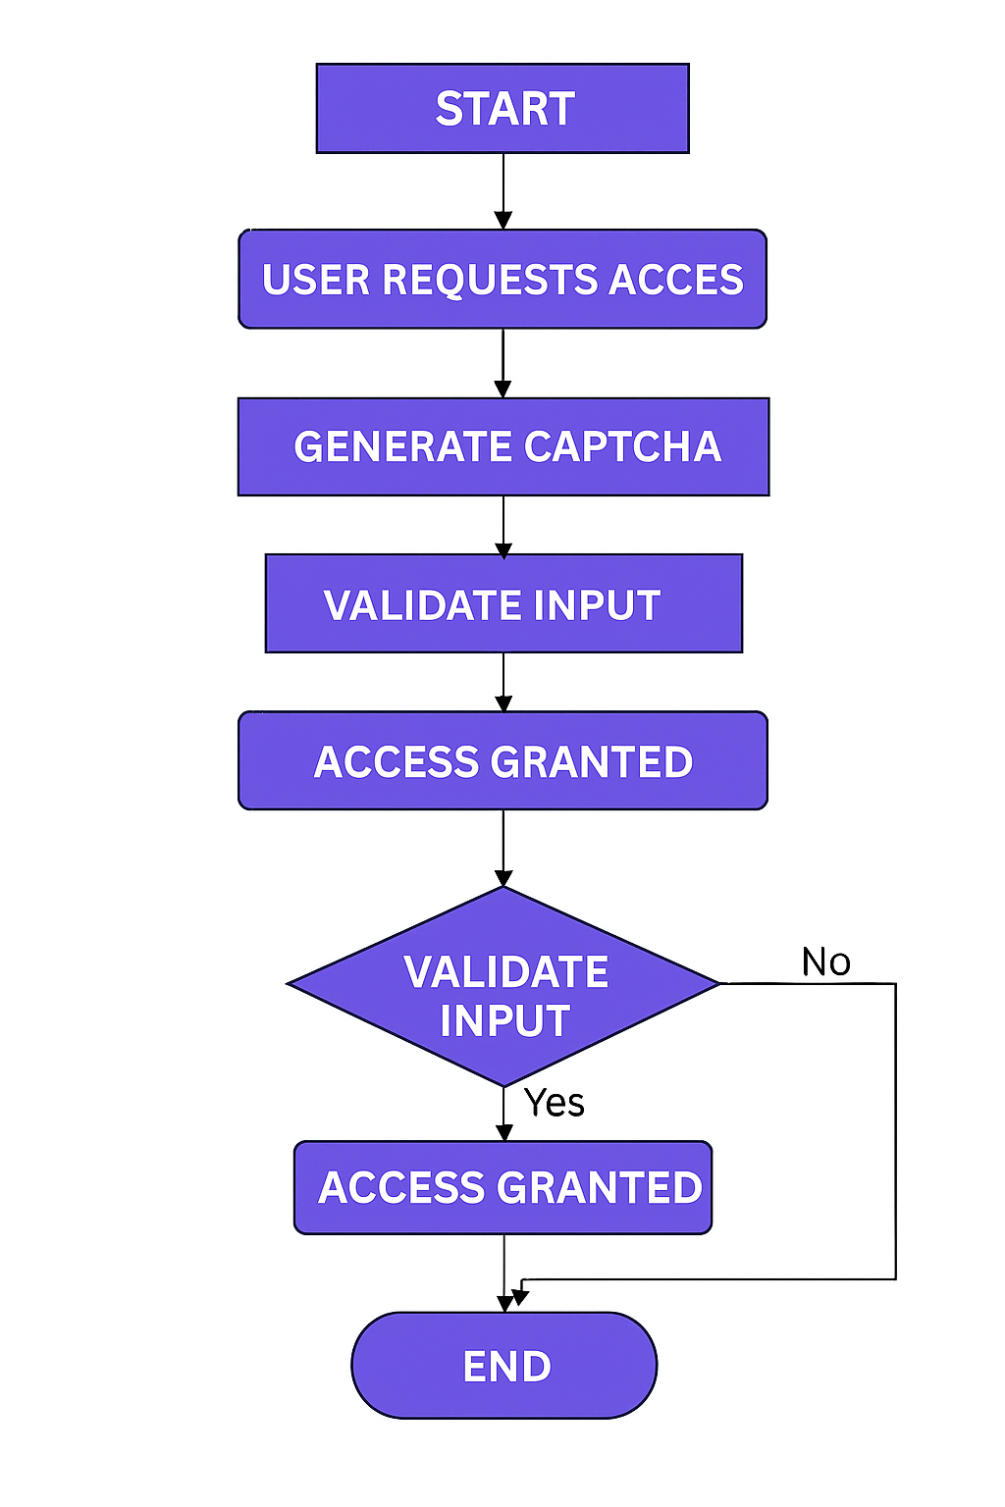
SYSTEM FLOWCHART
OOTs Using JAVA Project PPT 2025-26 Odd Sem

Slide 10
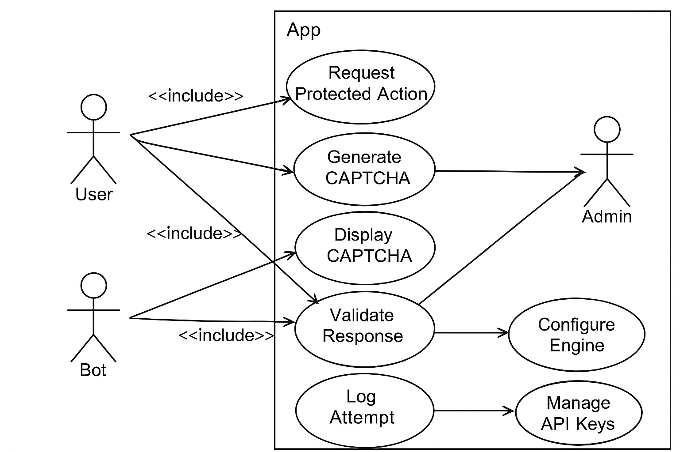
USE CASE/ER DIAGRAM
Use Cases:
View Movies
Select Seats
Book Tickets
Generate Bill
USE CASE DIAGRAM
OOTs Using JAVA Project PPT 2025-26 Odd Sem

Slide 11
FEASIBILITY STUDY
1. Technical Feasibility
The system can be developed using widely available technologies like Python, JavaScript, or PHP.
It supports integration with existing web frameworks (e.g., Flask, Django, Node.js).
Implementation requires basic web server setup and database support for session handling.
No special hardware is required — only standard computing resources.
2. Economic Feasibility
Development cost is low since it uses open-source tools and libraries.
Reduces dependency on paid third-party CAPTCHA services (like Google reCAPTCHA).
Long-term cost saving as the same CAPTCHA engine can be reused across multiple projects.
OOTs Using JAVA Project PPT 2025-26 Odd Sem

Slide 12
3. Operational Feasibility
Simple to integrate and manage by developers.
Provides a user-friendly interface for end-users.
Ensures high accuracy in distinguishing humans from bots.
Maintenance is minimal and can be easily handled by the development team
OOTs Using JAVA Project PPT 2025-26 Odd Sem

Slide 13
HARDWARE/SOFTWARE REQUIREMENTS
1.Hardware
Server (Min): 2 vCPU, 2–4 GB RAM, 20 GB SSD, 1 public IP
Server (Rec.): 4 vCPU, 8 GB RAM, 40+ GB SSD, HTTPS enabled
Client: Any device with a modern browser (desktop/mobile)
Optional: Redis cache (512 MB+), CDN for static assets
2.Software
OS (Server): Linux (Ubuntu 22.04+ / Debian 12) or Windows Server 2019+
Runtime (choose one):
Python 3.10+ (Flask/Django, Gunicorn/Uvicorn)
Node.js 18+ (Express/Fastify, PM2/Nginx
OOTs Using JAVA Project PPT 2025-26 Odd Sem

Slide 14
RESULT AND CONCLUSION
Results
Successfully developed a Reusable CAPTCHA Security Engine that can be integrated with various applications.
The system effectively prevents automated bot access through dynamic CAPTCHA generation.
Achieved secure validation and low response time during verification.
Conclusion
The project enhances web application security while maintaining user convenience.
It reduces dependency on external CAPTCHA providers and offers cost-effective protection.
The reusable architecture allows easy adaptation for future projects.
OOTs Using JAVA Project PPT 2025-26 Odd Sem

Slide 15
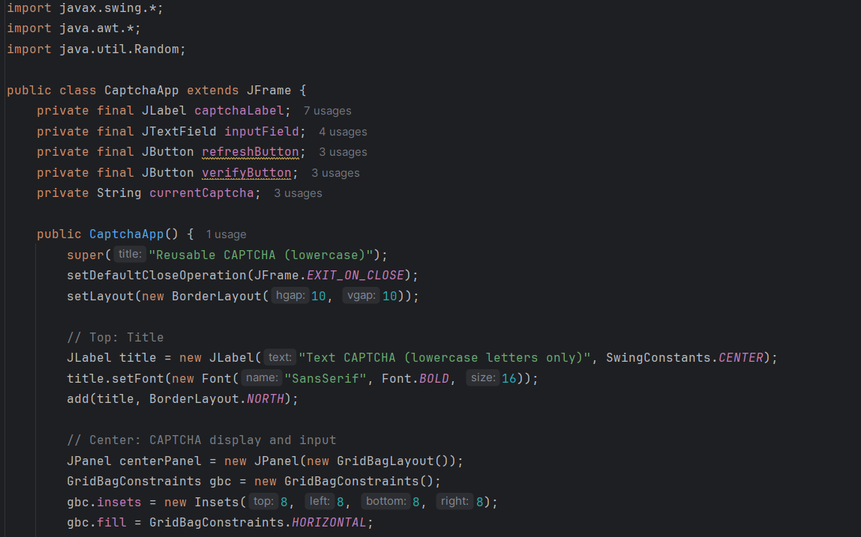
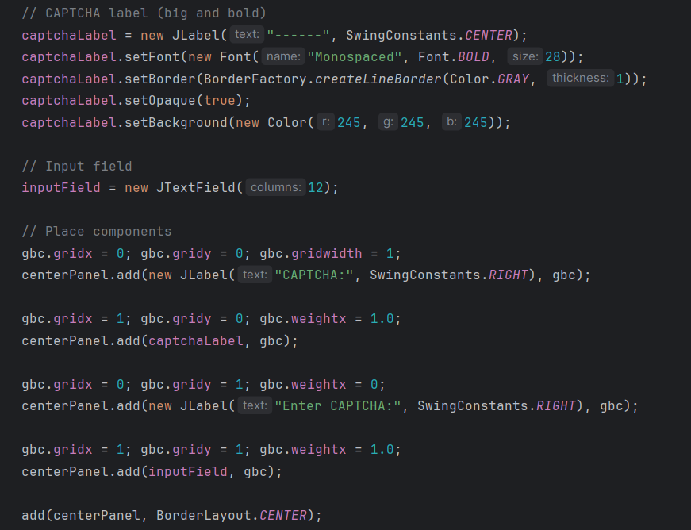
SNAPSHOTS OF PROGRAM:
OOTs Using JAVA Project PPT 2025-26 Odd Sem

Slide 16
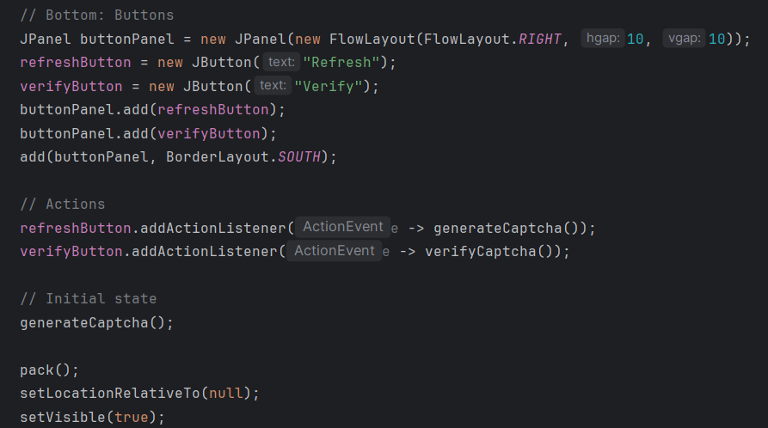
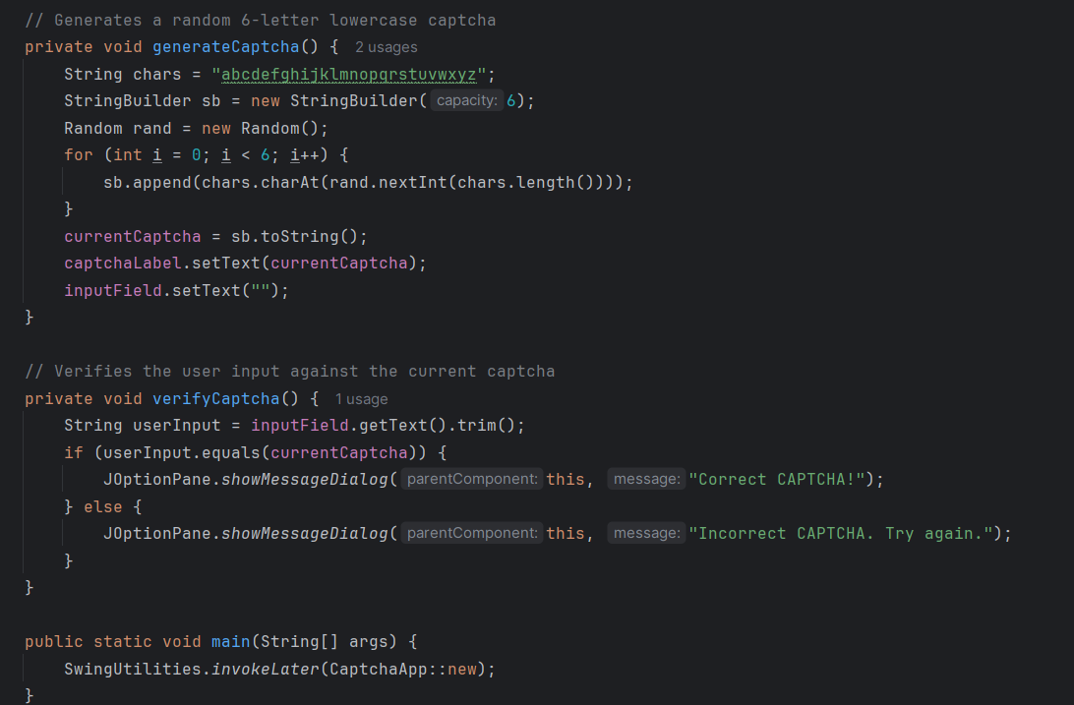
OOTs Using JAVA Project PPT 2025-26 Odd Sem

Slide 17
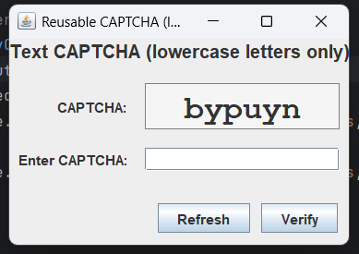
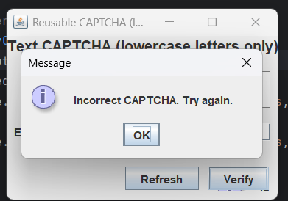
OUTPUT:
OOTs Using JAVA Project PPT 2025-26 Odd Sem

Slide 18
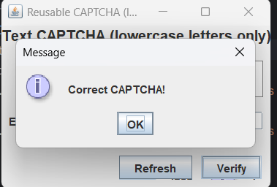
OOTs Using JAVA Project PPT 2025-26 Odd Sem

Slide 19
REFERENCES
Google reCAPTCHA Documentation – https://developers.google.com/recaptcha
hCaptcha Official Documentation – https://www.hcaptcha.com
OWASP Foundation, Automated Threat Handbook, OWASP, 2024 – https://owasp.org
Stack Overflow & GitHub repositories related to CAPTCHA implementation.
OOTs Using JAVA Project PPT 2025-26 Odd Sem

Slide 20
Content Format
Heading (+91 96394 01111Size: 32 Centre)
Subheading (Arial Font Size: 18-20 Left Aligned Bold)
Paragraph((Arial Font Size: 18-20 Justify Aligned)
Use same kind of bullet type in full document
References should be in following format (Times New Roman Font Size12 Justify Aligned)
[1]D. Du, X. Hu, "Steiner Tree Problems In Computer Communication Networks", World Scientific Publishing Company, 2008.
[2] Boon Ping Lim, Poh Kit Chong, Ettikan Kandasamy Karuppiah, Yaszrina Mohamad Yassin, Amril Nazir, Mohamed Farid Noor Batcha “FARCREST: Euclidean Steiner Tree-based Cloud Service Latency Prediction System”(2013) in 10th annual IEEE CCNC.
OOTs Using JAVA Project PPT 2025-26 Odd Sem

Slide 21
Thank You
OOTs Using JAVA Project PPT 2025-26 Odd Sem

Slide 22
Feedback from the Panel
The panel wants the team to :
OOTs Using JAVA Project PPT 2025-26 Odd Sem

